Slide 1

WELCOME
TAUKIR AHMED
ROLL: 12
CLASS: WDD – 5
ADDRESS: Shajahanpur, Bogura

Slide 2
WEB DESIGN AND DEVLOPMENT PRESENTAION
BATCH - 5
CLASS - 6
TOPIC: MICROSOFT POWERPOINT

Slide 3
What is MS Powerpoint?
MS PowerPoint is a presentation software developed by Microsoft that allows users to create dynamic slide shows with text, images, and video. It is part of the Microsoft Office suite and helps users visually communicate ideas for professional, academic, or casual purposes.
Key features include:
various slide layouts
design templates
options for adding animations
and transitions.

Slide 4
TABLE
Name | Bangla | English | Math | Total
Name 1 | 90 | 95 | 100 | 285
Name 2 | 40 | 60 | 70 | 170
Name 3 | 80 | 90 | 85 | 255
Name 4 | 90 | 95 | 75 | 260
Name 5 | 95 | 90 | 85 | 270

Slide 5
Family Tree of Albert Einstein
Albert Einstein
Mileva Marić
Lieserl Einstein
Hans Albert Einstein
Eduard Einstein
Elsa Löwenthal
Bernhard Caesar Einstein
Klaus Martin Einstein
Evelyn Einstein (adopted)

Slide 7
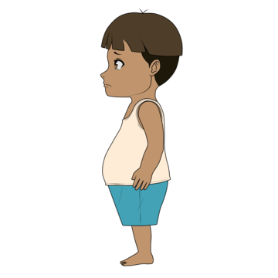

Slide 8

THANKYOU

